Slide 1
Creating character class via dialogue events.
Michael Craddock

Slide 2
So what is this?
A system that can help to create class identity in primarily roleplaying games(RPGS) by giving the player choice in how their class grows.
It will take away the standard choose your class at the beginning and allow the player to grow a class along side their character

Slide 3
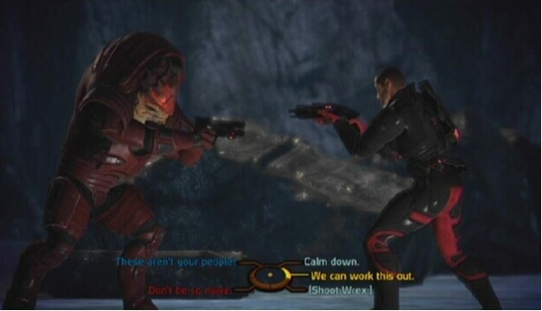
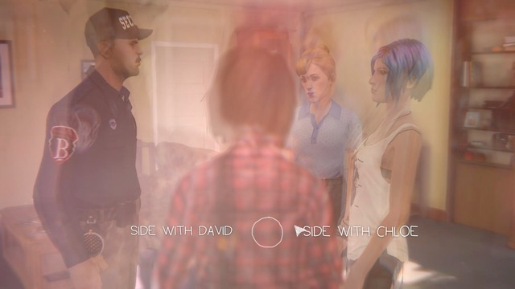
What do I mean by this?
Games currently have evolved and have gotten to the point where character identity and choices is great, with games like mass effect, Life is strange and the walking dead pushing forward story.
However I feel that class fantasy and identity in RPGs have been taking a back seat.

Slide 4
How does the system works
It relies on certain aspects to help it allow an entertaining and fun experience for the player.
The theory behind this system includes having good knowledge of Multiple choices and how they work, how to create meaningful choices and how to use storytelling to create an interesting narrative.

Slide 5
Multiple choices
We’ll be looking at an interesting blog created by Dan Fabulich(Choiceofgames.com, 2010) on what goes into creating good multiple choices.
“Every option should have real consequence, the player needs some basis to make a decision, No options should be better than the other”

Slide 6
Multiple choices
“Even if you’re guaranteed that every option has consequences, if players have no idea what the consequences of their decisions will be, it becomes impossible to make a meaningful choice.”

Slide 7
Meaningful choices
Choices need to feel meaningful to make the player want to choose them.
They need to have impact and consequence to them.
They need to let the player know what their getting into.

Slide 8
Meaningful choices
We’ll be looking at an article on Gamasutra by Brice Morrison about his interpretations on meaningful choices in gaming and using them as our starting points.
“If the player is not aware they are making a choice between two or more options, then it isn’t meaningful.”
“If you don’t remember your previous choices, then you’ll never feel pride or regret. Or if your previous choices don’t affect your present world, then you will similarly not feel anything.”

Slide 9
Meaningful choices
“Imagine that a player is in a game where a character named Cindy is crying for help. The player runs over and helps Cindy. At that moment the game says you choose to save Cindy over Bernard. But the player never saw Bernard. They didn’t even know Bernard was in trouble, or that he even existed. At this point the player would probably feel frustrated. This ruins the choice and makes it meaningless.”

Slide 10
Storytelling
Whilst it might seem obvious a good story is what really ties everything together and helps involve the player in the class.
Trying to mix story and gameplay together can be tricky and making it work smoothly needs work.

Slide 11
Storytelling
Storytelling games tend to use a system called the string of pearls.
“The idea is that a completely non-interactive story (the string) is presented in the form of text, a slideshow, or animated sequence and then the player is given a period of free movement and control (the pearl) with a fixed goal in mind. When the goal is achieved, the player travels down the string via another non-interactive sequence, to the next pearl.” (Schell, 2008)

Slide 12
Storytelling
Whilst the string of pearls is great, it does not work in a system with multiple choices, however it can be edited to fit our system.
Fitting it does require a LOT of work as you need to keep track of all choices, how they interact with each other and how they can smoothly transition with each other.

Slide 13
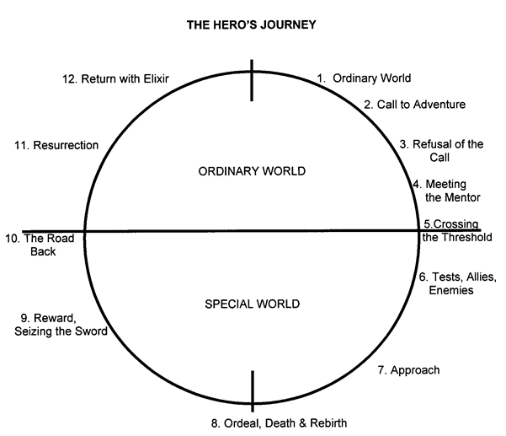
Storytelling
Making sure the player has goals to work towards.
Using simplicity and transcendence to help create the story.
Using the Heroes journey by Christopher Vogler as a starting point.

Slide 14
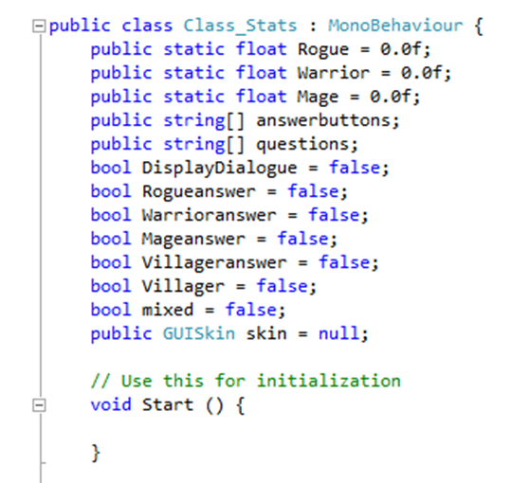
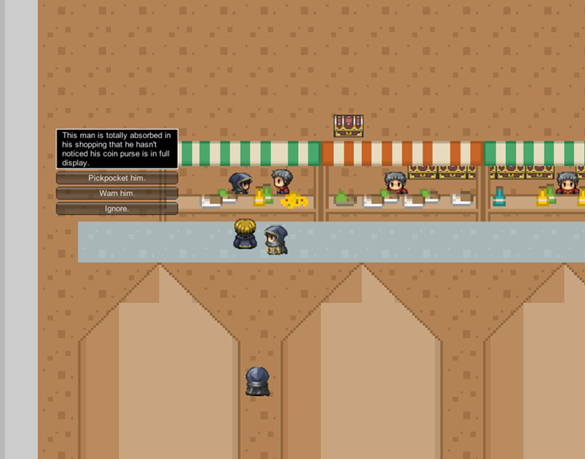
So what’s in the project?
A 2D RPG in a small village.
10 different events some with their own unique unlock and multiple choice options.
Storage of data from choices.

Slide 15
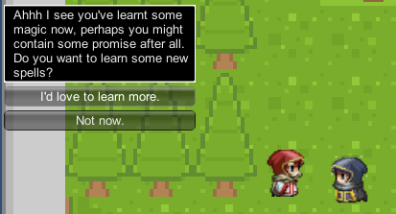
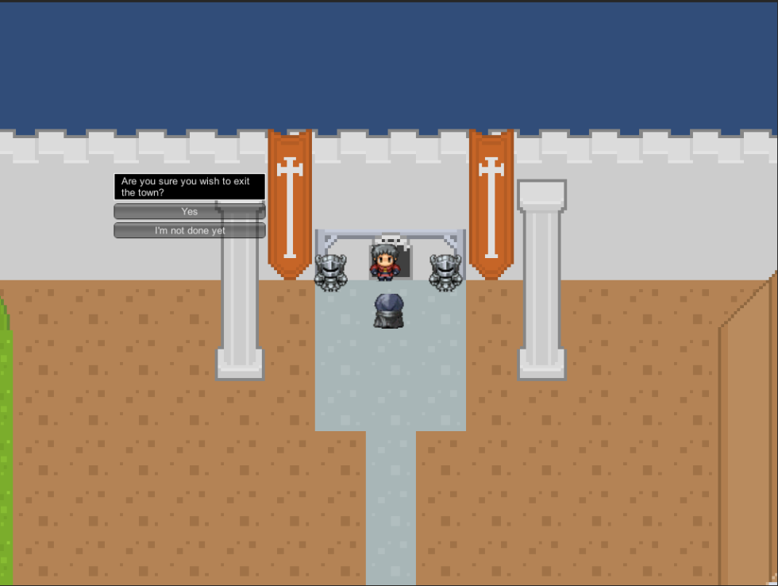
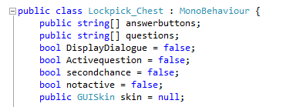
Implementation
Information regarding class stats were recorded via public static floats that are attached to the player.
Conversations were done via strings and inputting the dialogue in the inspector.
Booleans were used for triggering events or certain conversations when certain events were true.

Slide 16
Tester feedback
Tested on a variety of different players (Offline player, Online players and very casual players)
Mostly positive feedback on the system.
It could work very well as a tutorial level.
Might be tricky to work out throughout the entire game.
More “Hardcore” players prefer this whilst more casual players say they’d enjoy it once but the scope could confuse them.
Online players did not like the idea for an Online game.

Slide 17
My thoughts
Overall happy with how things turned out.
Very interested in the feedback results.
Disappointed I wasn’t able to implement all of the coding features I initially thought I could do.

Slide 18
Thank you for listening!
Questions?

Slide 19
Bibliography
Bethesda Game Studios.(2010). Elder Scrolls: Skyrim.[DISC]. PC/Xbox 360/PS3. Rockville: Bethesda Softworks
Bioware. (2007). Mass Effect.[DISC]. Xbox 360. Edmonton: EA Games
Bioware. (2009). Dragon Age.[DISC]. Xbox 360. Edmonton: EA Games
Dontnod Entertainment.(2015). Life Is Strange.[DIGITAL] PC. Paris: Square Enix
Fabulich, D. (2010, March 28). 5 Rules for Writing Interesting Choices in Multiple-Choice Games. Retrieved August 29, 2016, from choiceofgames.com: https://www.choiceofgames.com/2010/03/5-rules-for-writing-interesting-choices-in-multiple-choice-games/
Montgomery, R. A. (1979). Journey Under the Sea. Waitsfield: Chooseco.
Morrison, B. (2013, September 19). Meaningful Choice in Games: Practical Guide & Case Studies. Retrieved September 1, 2016, from Gamasutra: http://www.gamasutra.com/blogs/BriceMorrison/20131119/204733/Meaningful_Choice_in_Games_Practical_Guide__Case_Studies.php
Schell, J. (2008). The Art of Games design a Book of Lenses. Burlington : Morgan Kaufmann.
Telltale Games.(2012). The Walking Dead.[DIGITAL].PC. San Rafael: TellTale Games
Vogler, C. (2007). The Writer's Journey: Mythic Structure for Writers. California: Michael Wiese Productions.
Vogler, C. (n.d.). The Hero's Journey Outline. Retrieved September 2, 2016, from The writers journey: http://www.thewritersjourney.com/hero's_journey.htm#Hero

